Slide 1
Spectrometer Simulation
through interference fringe
Nan

Slide 2
Outline
Schematics
Simulated beam profiles
Added spectrometer (crystal -> lens)
Simulated beam profiles
Effect of time shift
Effect of incident photon energy difference
Effect of pulse front tilt
Effect of chirp
Added spectrometer (lens -> crystal)
Same as above

Slide 3
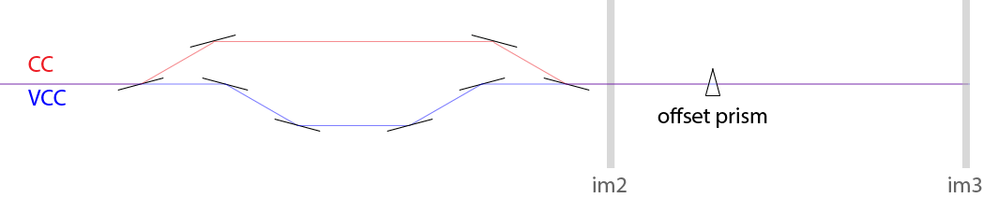
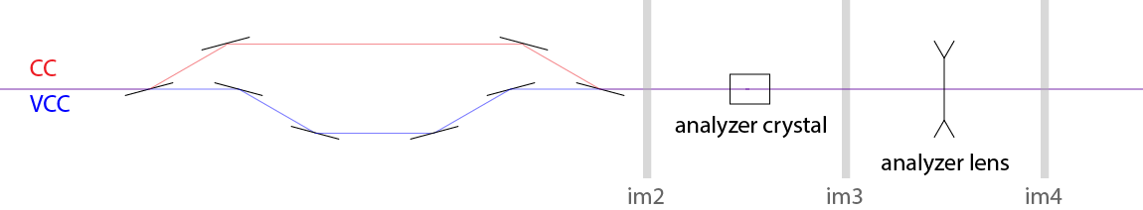
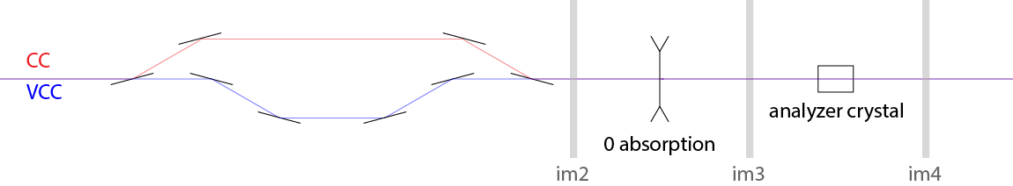
Beamline optics schematics
Regular setup similar to Yanwen’s experiment
Adding spectrometer
Ray-tracing geometry

Slide 4
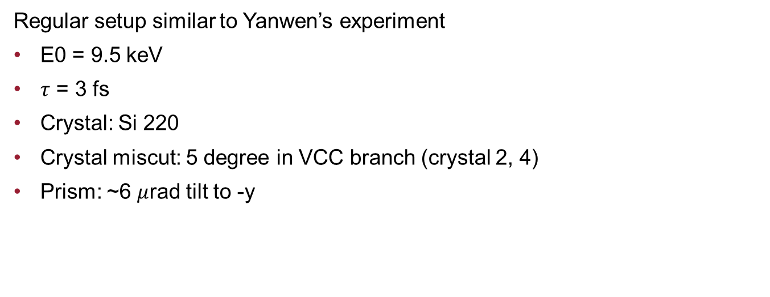
Beamline optics schematics
Regular setup similar to Yanwen’s experiment
E0 = 9.5 keV
$τ$ = 3 fs
Crystal: Si 220
Crystal miscut: 5 degree in VCC branch (crystal 2, 4)
Prism: ~6 $μ$rad tilt to -y

Slide 5
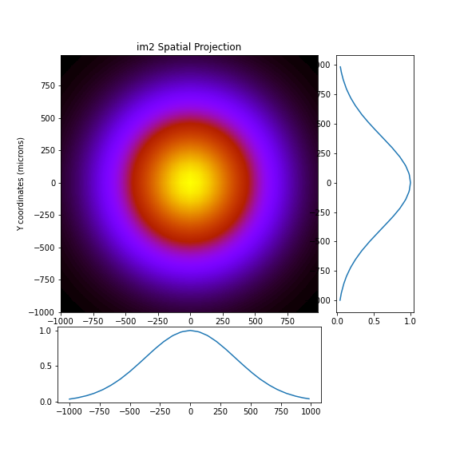
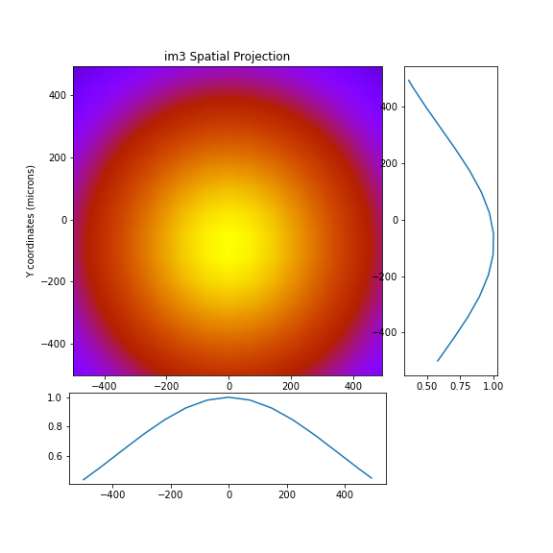
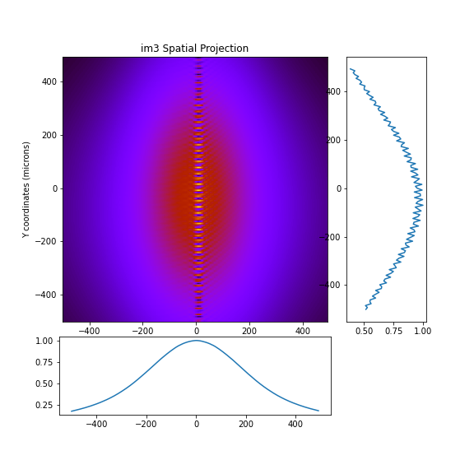
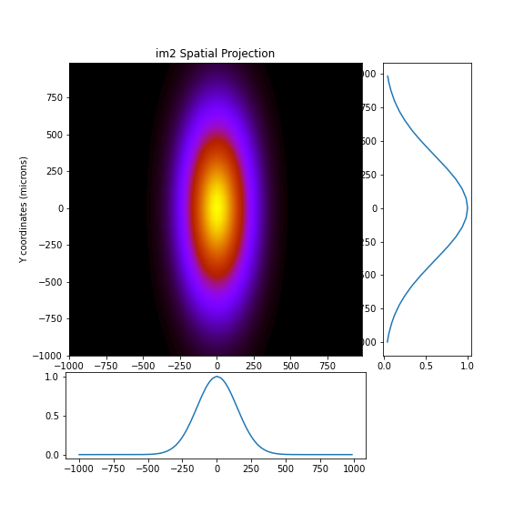
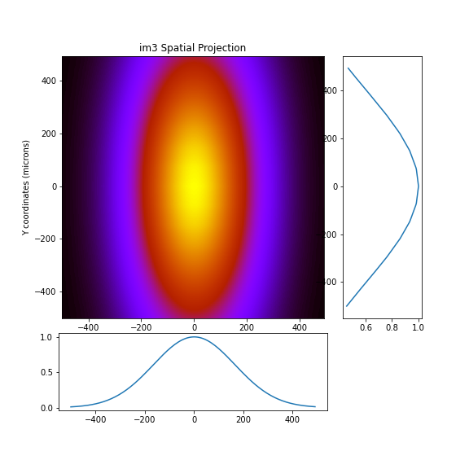
Beam profiles (xy)
Sum
CC
VCC

Slide 6
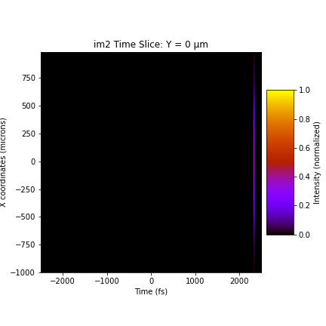


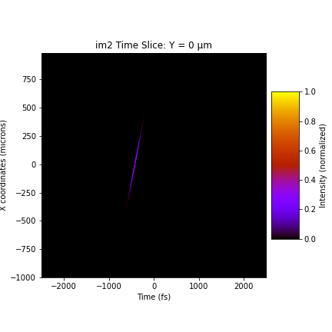

Pulse front tilt (xt)
Sum
CC
VCC
Two branches are manually shifted in time so that they overlap

Slide 7
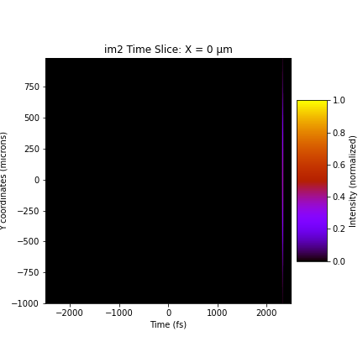



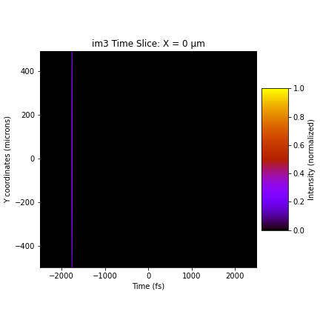
Pulse front tilt (yt)
Sum
CC
VCC

Slide 8
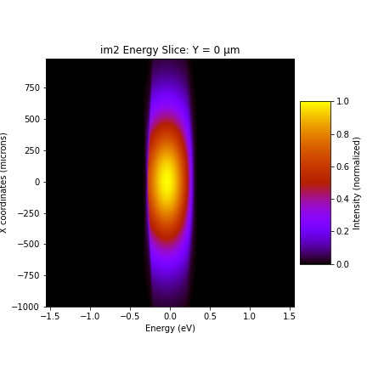
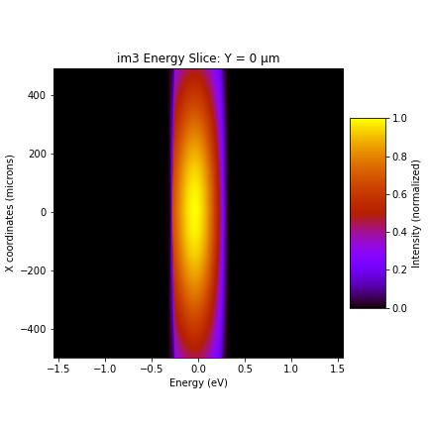
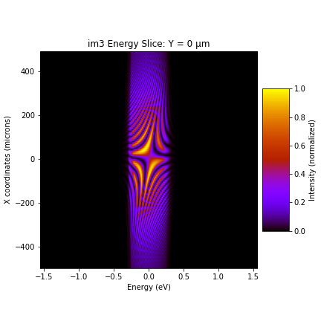
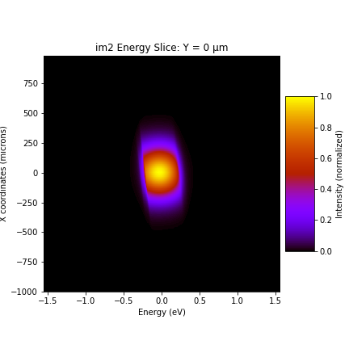
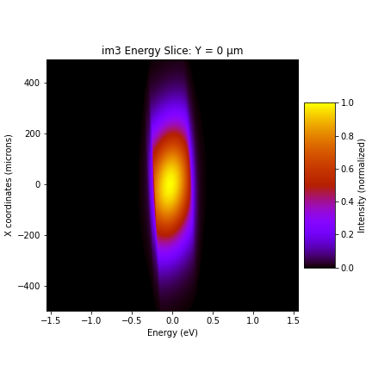
Energy components (x vs E)
Sum
CC
VCC
Two branches are manually shifted in time so that they overlap

Slide 9

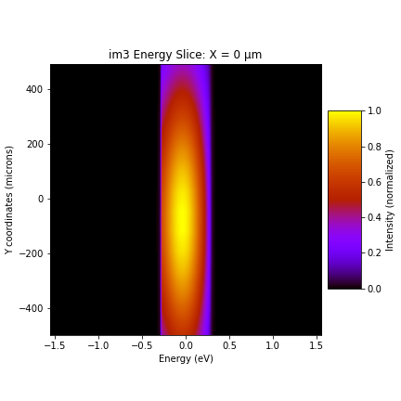


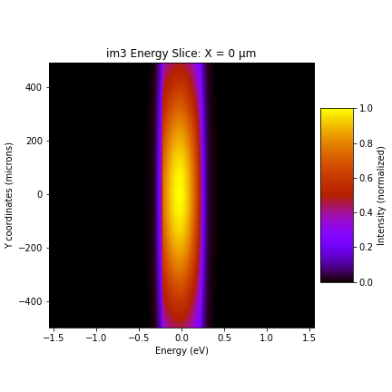
Energy components (y vs E)
Sum
CC
VCC

Slide 10
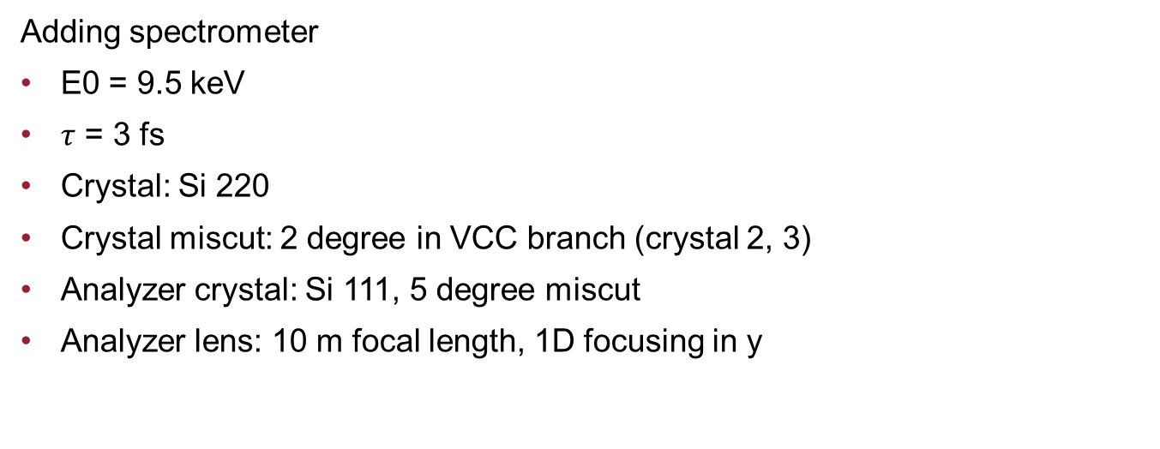
Beamline optics schematics
Adding spectrometer
E0 = 9.5 keV
$τ$ = 3 fs
Crystal: Si 220
Crystal miscut: 2 degree in VCC branch (crystal 2, 3)
Analyzer crystal: Si 111, 5 degree miscut
Analyzer lens: 10 m focal length, 1D focusing in y

Slide 11

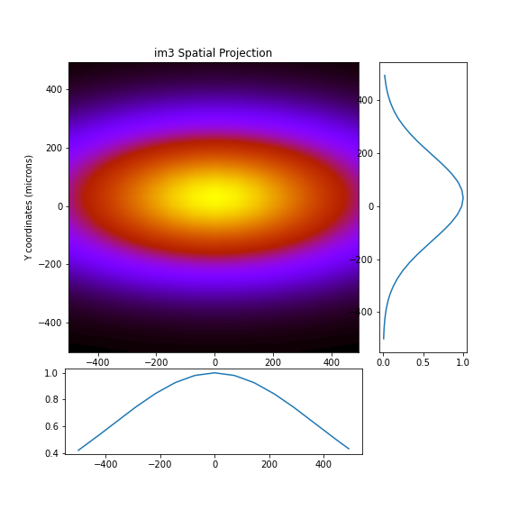
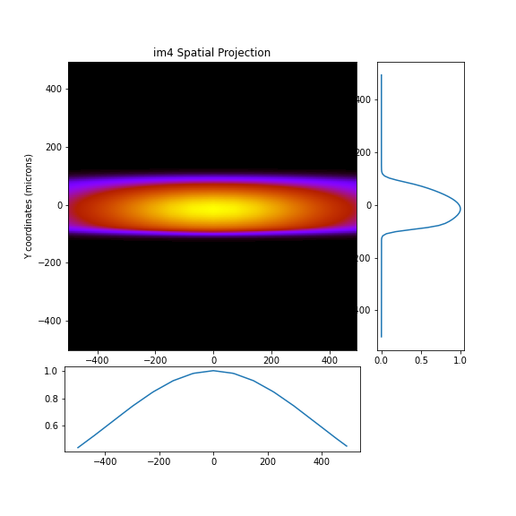
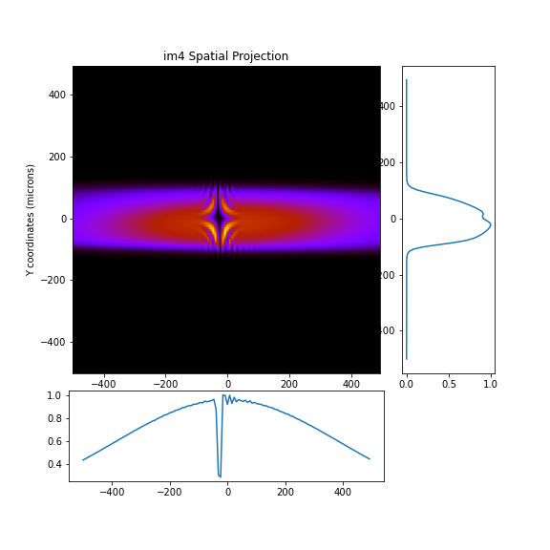
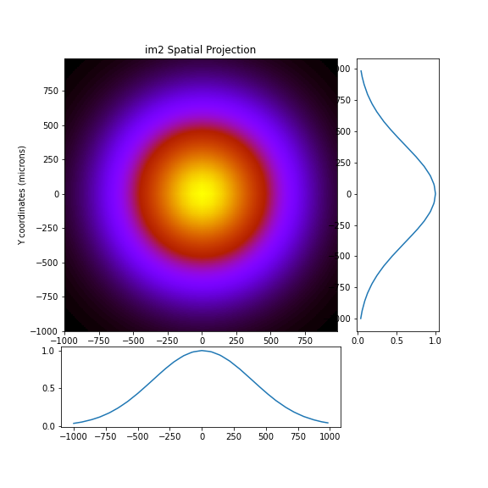
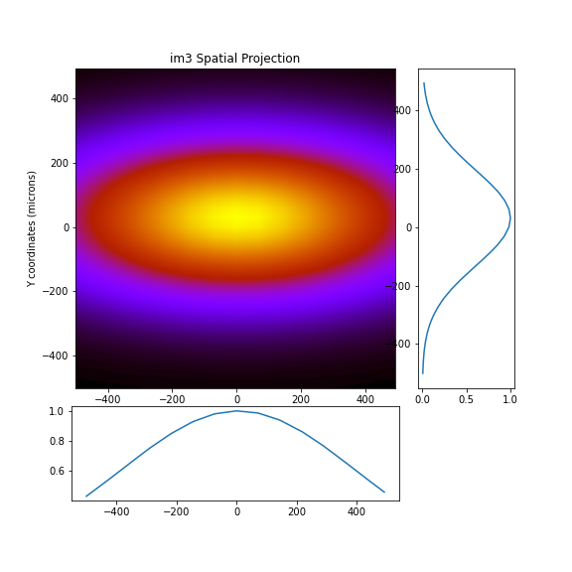
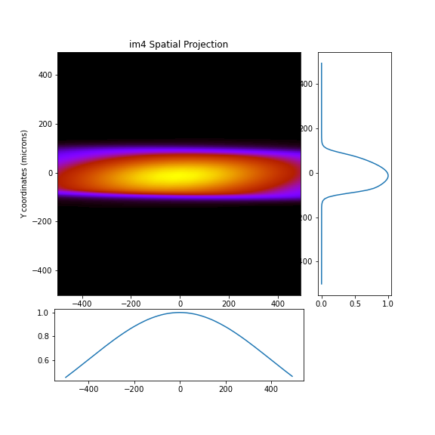
Beam profiles (xy)
CC
Sum
VCC

Slide 12

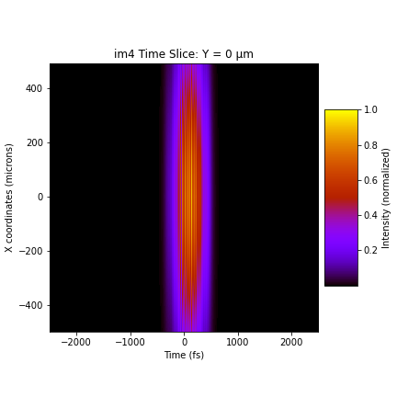
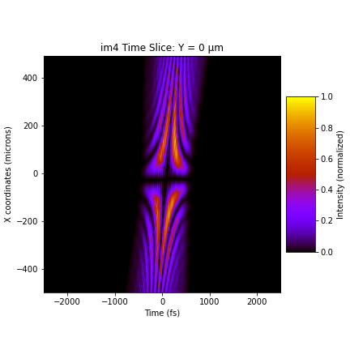


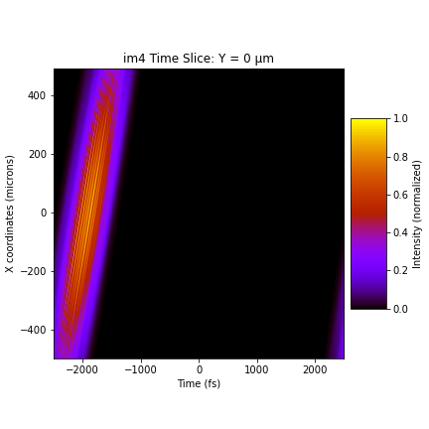
Pulse front tilt (xt)
CC
Sum
VCC

Slide 13

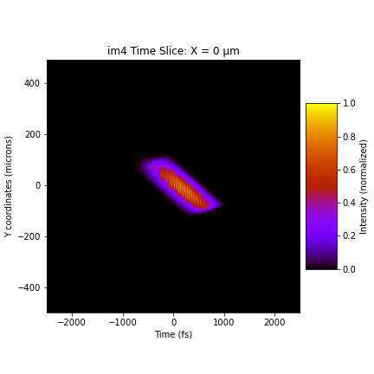
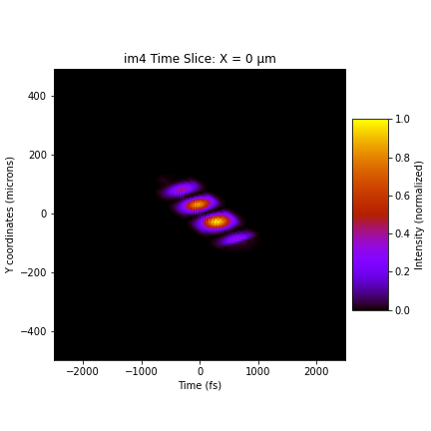


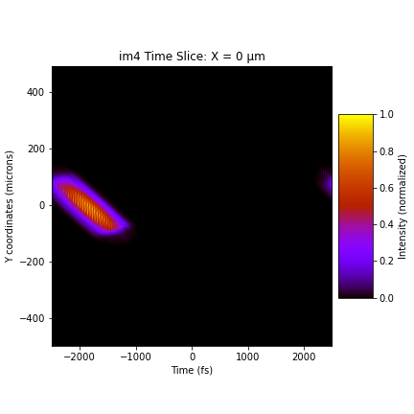
Pulse front tilt (yt)
CC
Sum
VCC

Slide 14

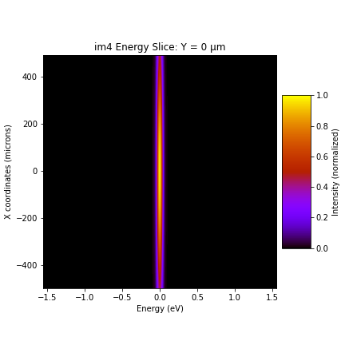
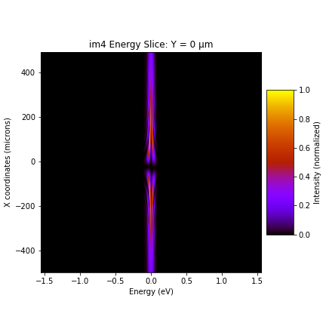

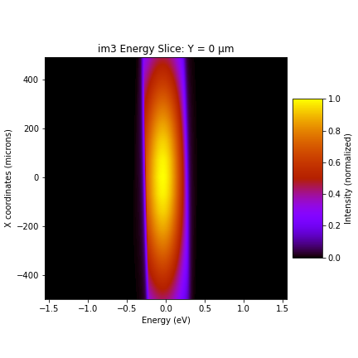

Energy components (x vs E)
CC
Sum
VCC

Slide 15
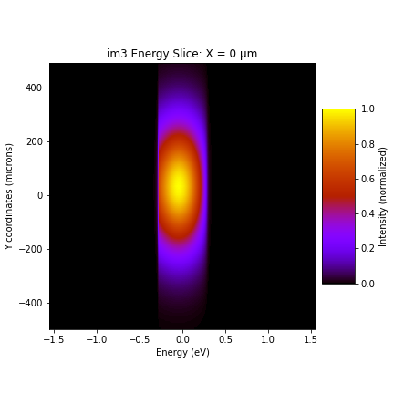
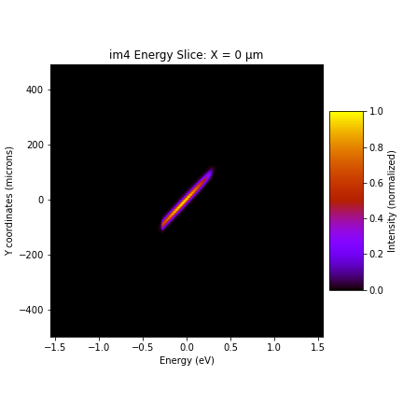
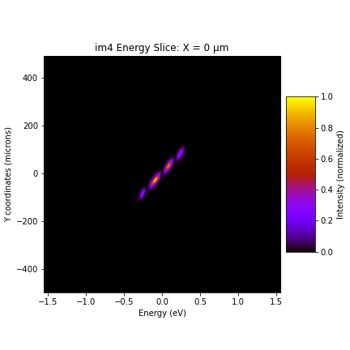

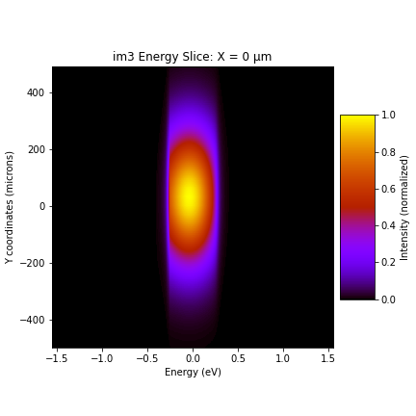
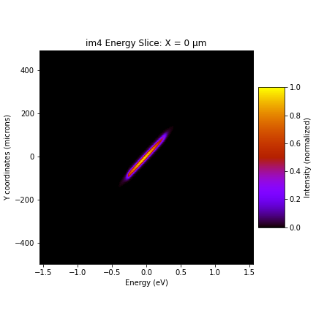
Energy components (y vs E)
CC
Sum
VCC

Slide 16
Effect of time shift
CC
At the image plane, manually shifting the VCC branch in time by [-20, -10, 0, +10, +20 fs] so the two branches overlap differently in space
VCC

Slide 17
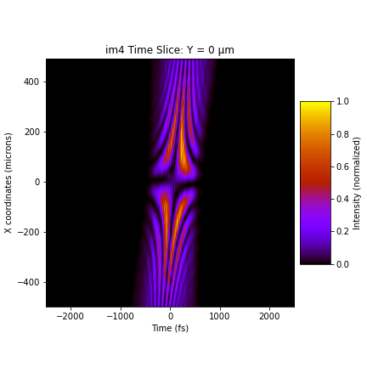

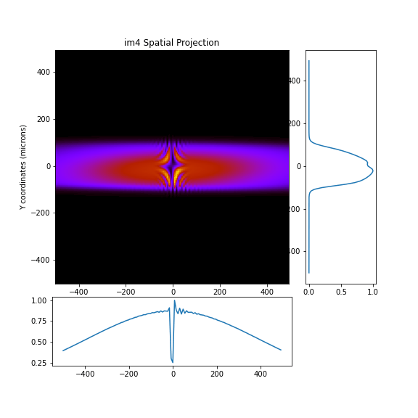


Effect of time shift
x vs t
y vs t
profile
x vs E
y vs E

Slide 18

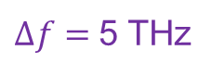
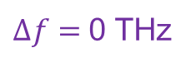
Effect of energy difference, beam profile (xy)
$Δf=$0 THz
$Δf=$5 THz
Adding a 5 THz (~ 20meV) difference in the incident pulse for the CC branch

Slide 19
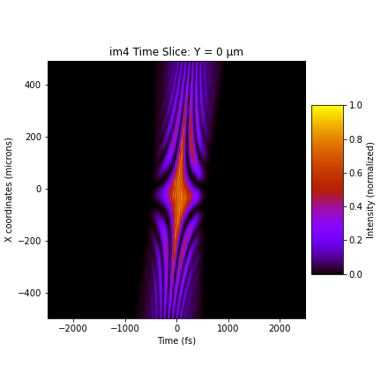
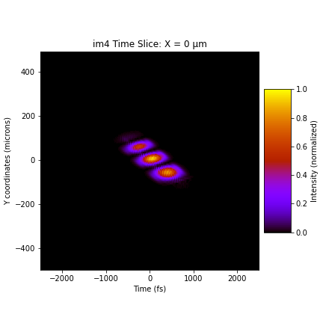

Effect of energy difference, pulse front tilt
$Δf=$0 THz
$Δf=$5 THz
x vs t
y vs t

Slide 20


Effect of energy difference, energy profile
$Δf=$0 THz
$Δf=$5 THz
x vs E
y vs E

Slide 21
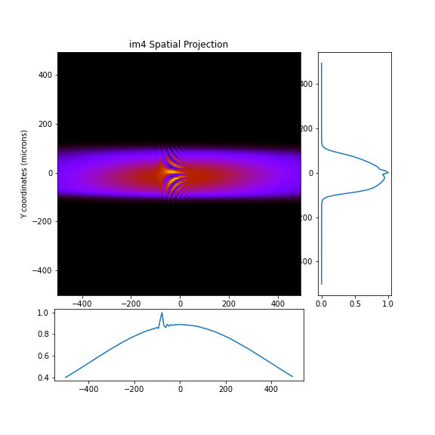

Effect of tilt, beam profile (xy)
tilt = 0
tilt = 4 $μ$rad
Manually tilt the CC branch to –y at im4

Slide 22
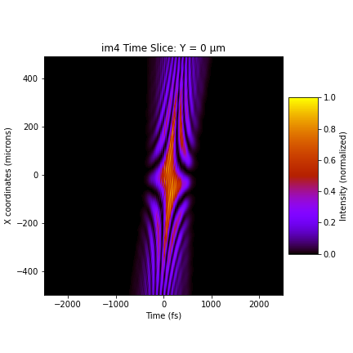

Effect of tilt, pulse front tilt
tilt = 0
tilt = 4 $μ$rad
x vs t
y vs t

Slide 23


Effect of tilt, energy profile
tilt = 0
tilt = 4 $μ$rad
x vs E
y vs E

Slide 24

Effect of chirp, beam profile (xy)
3 fs
100 fs
Group delay dispersion ~ 100 fs^2

Slide 25


Effect of chirp, pulse front tilt
3 fs
100 fs
x vs t
y vs t

Slide 26


Effect of chirp, energy profile
3 fs
100 fs
x vs E
y vs E

Slide 27
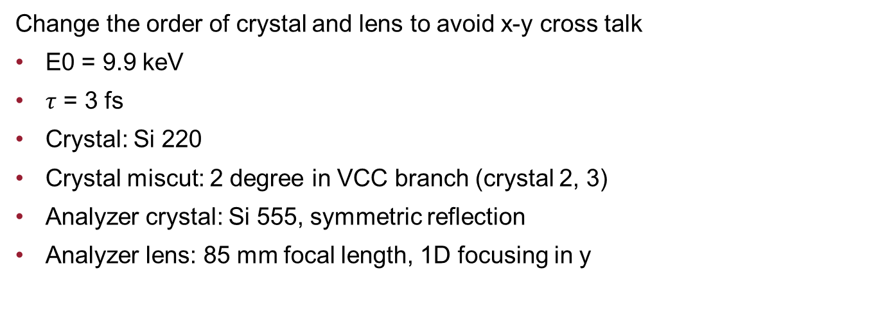
Beamline optics schematics
Change the order of crystal and lens to avoid x-y cross talk
E0 = 9.9 keV
$τ$ = 3 fs
Crystal: Si 220
Crystal miscut: 2 degree in VCC branch (crystal 2, 3)
Analyzer crystal: Si 555, symmetric reflection
Analyzer lens: 85 mm focal length, 1D focusing in y

Slide 28







Beam profiles (xy)
CC
Sum
VCC

Slide 29







Pulse front tilt (xt)
CC
Sum
VCC

Slide 30







Pulse front tilt (yt)
CC
Sum
VCC

Slide 31







Energy components (x vs E)
CC
Sum
VCC

Slide 32






Energy components (y vs E)
CC
Sum
VCC

Slide 33





Effect of time shift
x vs t
y vs t
profile
x vs E
y vs E
shifting the VCC branch in time by [-20, -10, 0, +10, +20 fs]

Slide 34


Effect of energy difference, beam profile (xy)
$Δf=$0 THz
$Δf=$5 THz
Adding a 5 THz (~ 20meV) difference in the incident pulse for the CC branch

Slide 35


Effect of energy difference, pulse front tilt
$Δf=$0 THz
$Δf=$5 THz
x vs t
y vs t

Slide 36




Effect of energy difference, energy profile
$Δf=$0 THz
$Δf=$5 THz
x vs E
y vs E

Slide 37

Effect of tilt, beam profile (xy)
tilt = 0
tilt = 4 $μ$rad
Manually tilt the CC branch to –y at im4

Slide 38


Effect of tilt, pulse front tilt
tilt = 0
tilt = 4 $μ$rad
x vs t
y vs t

Slide 39


Effect of tilt, energy profile
tilt = 0
tilt = 4 $μ$rad
x vs E
y vs E

Slide 40

Effect of chirp, beam profile (xy)
3 fs
100 fs
Manually shift the CC branch in +y at im4

Slide 41


Effect of chirp, pulse front tilt
3 fs
100 fs
x vs t
y vs t

Slide 42


Effect of chirp, energy profile
3 fs
100 fs
x vs E
y vs E

